Slide 1




API Marketplace (WSO2)
User Registration req.
Accept
Billing Engine
[App Creation req.]
Create & Publish APIs
Admin
Approve
Create Subscription Plans
Billing Plans
Customer registrations
[Subscription req.]
Approve
Billing Calculation
Dispute Management
API Usage
Invoices generations
Payment Method (JP)

Slide 2
1
Admin

Slide 3
API MarketPlace Business Architecture
API MarketPlace
API Manager
Developer Portal
Jawwal Pay
Middleware Layer
Publisher
Elastic Search
Billing Layer
Billing Calculations & Invoicing
Billing Plans / Tariffs
Collection Management
CRM
Payment Management
WSO2
Billing domain
Jawwal Domain

Slide 4


API Market Place Process & Flow
Invoke
Clients
Register
Pay
API Manager
Developer Portal
Jawwal Pay
Create & Publish API
Record Consumption
Publisher
Elastic Search
Generate Invoices
Load API Consumptions
Billing Calculations
Feed Prices
Adjust Balances
Billing Plans / Tariffs
Dispute Management
Manage Disputes
Register Payments
Manage & Operate
CRM
Payment Management
Define Customers in the CRM
Jawwal Business

Slide 6
API Market Place Business Architecture
API Market Place
API Manager
Developer Portal
Jawwal Pay
Middleware Layer
Publisher Portal
Elastic Stack
Database
Billing Layer
Billing Calculations & Invoicing
Billing Plans / Tariffs
Collection Management
CRM
Payment Management
WSO2
Billing domain
Jawwal Domain

Slide 7
API Market Place Process & Flow
Clients
Register
Pay
Invoke
Developer Portal
API Manager
Jawwal Pay
Register Payments
Create & Publish API
Record Consumption
Publisher Portal
Create Subscription Plans
Jawwal Developers
Elastic Stack
Database
Load API Consumptions
Billing Plans / Tariffs
Feed Prices
Generate Invoices
Define Customers in the CRM
Billing Calculations & Invoicing
Adjust Balances
CRM
Payment Management
Manage & Operate
Jawwal
Business
Manage Disputes
Dispute Management

Slide 8
Jawwal Developers

Slide 9
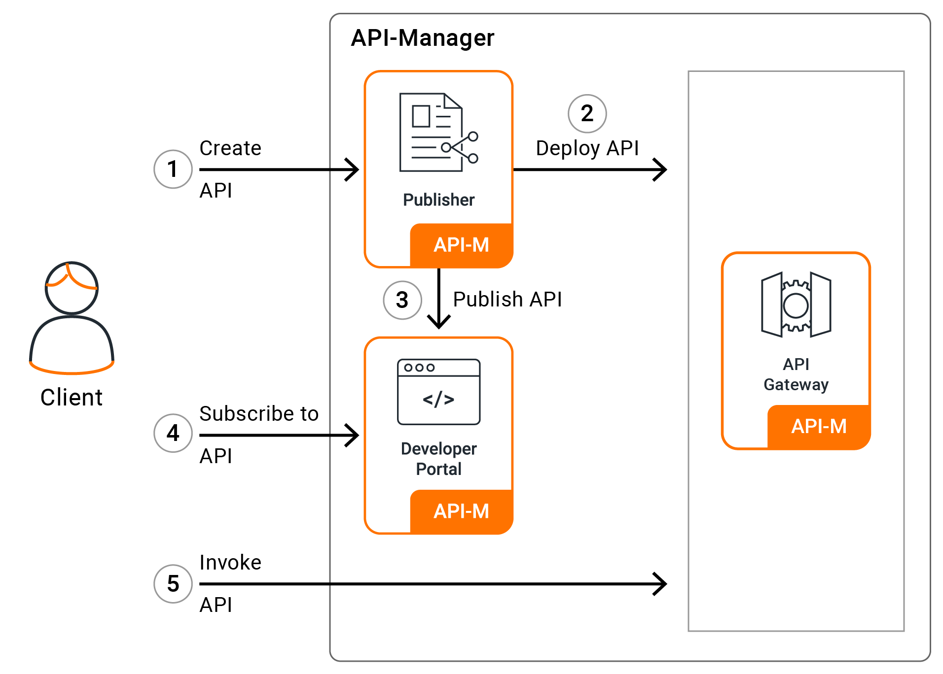

Slide 10
